Slide 1
Final Project
Ball Labyrinth
Ball Labyrinth

Slide 2
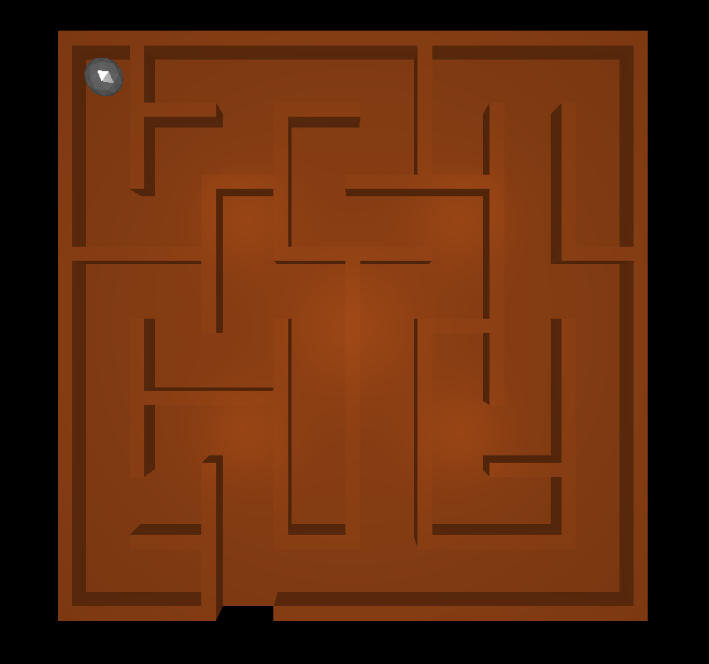
Introduction
OpenGL
SDL2
GLM

Slide 3
Physics Model
3D rigid body model
Ball represented as center with radius
Walls represented as boxes with infinite mass
Symplectic Euler used as update step
Simple ball rolling:
  No torque
  No slip on the surface assumed

Slide 4
Rolling Ball
Angular momentum can be seen as reduced force acting on the ball
Rolling
Sliding

Slide 5
Rolling friction
Friction is a constant force dependent on the normal force to the surface

Slide 6
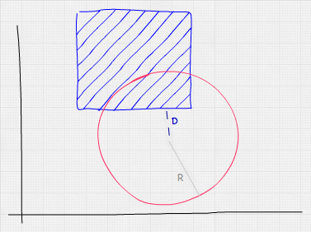
AABB collision detection
AABB boxes used to model the maze and floor
Sphere to AABB collision detection
https://developer.mozilla.org/en-US/docs/Games/Techniques/3D_collision_detection/Bounding_volume_collision_detection_with_THREE.js

Slide 7
Collision Steps
Detect if distance to
centerpoint < radius
Move ball outside of the collision box
Update velocity according to rigid body model

Slide 8
Maze Generation
Random automatic maze generation
http://www.thingiverse.com/thing:24604
Python script generates openscad file and .txt file with AABB boxes
Openscad → generates .stl
Blender → .obj from .stl
Tiny Obj Loader used to import the .obj maze

